Slide 1




Distributed Graph Simulation: Impossibility and Possibility
Wenfei Fan
Xin Wang
Yinghui Wu
Dong Deng
University of Edinburgh
Southwest Jiaotong University
Washington State University
Tsinghua University

Slide 2








Finding potential customers
“find me Youtube users who like beer ads connected with a community of those who like worldcup videos, soccer fans and beer lovers”
Youtube users (YB)
Interest = “beer ads”
f₁
f₄
yb₃
Youtube users (YF)
Interest = “2014
FIFA worldcup”
Food (F)
Interest = “beer”
yf₁
sp₃
yb₁
yf₃
sp₁
Sports (SP)
Interest = “soccer”
f₂
yb₂
sp₂
yf₂
f₃
distributed social network

Slide 3
Searching distributed graphs
Real life graphs are distributed : Computational or Natural
Geo-distributed data centers
Decentralization social networks
Distributed knowledge bases: entity and personal information
Distributed graph querying
given a pattern Q and a graph G fragmented into F = (F₁,…F_{n}) (F_{i} distributed to site S_{i}), compute answer Q(G)
applications: social analysis, multi-source knowledge management

Slide 4

Distributed Querying Methods
Graph exploration/Message passing
Master node and slave node (Trinity (Microsoft), Pregel (Google))
Predefined graph partition and query execution plan
Vertex centric/Local scheduling: GraphLab (CMU)
Ideally we want a distributed algorithm to take
less response time with more sites, independent with entire data graph
data shipment cost decided by query size and number of sites only
query
intermediate
results
...
query plan
Unbounded cost
master node
slave node
(fragments)
query result
Notes:
pregel: inspired by Valiant’s Bulk Synchronous Parallel model (1990).
Partition graphs into clusters following a specific strategy
Selects a master node and assign each cluster to a slave node.
Using effective partition strategy and sophisticate query plans, the method can be efficient over large graphs.
Question: Can we achieve performance guarantees regardless of how the graph is partitioned, and via some simple query framework that can only benefit from query plans if specified?
4

Slide 5
Distributed graph simulation
Graph simulation
a graph G matches a pattern P if there exists a matching relation S
for each pair (u, v) in S, v is a node match of u
for each edge (u, u’), there exists an edge (v, v’) and (u’, v’) is in S
Distributed graph simulation
Distributed data graph with in-nodes and virtual nodes
Given distributed data graph G and query Q, find match set
Q(G) induced by S
virtual
node
in-node

Slide 6
Undoable: Parallel Scalability
A distributed graph simulation algorithm A is parallel scalable in
response time if its running time is bounded by a polynomial in |Q| and |Fm|, (Fm is the largest fragment)
data shipment if ships at most a polynomial amount of data in |Q| and |F|
Impossibility Theorems
Intuition of proof: simulation lacks data locality
holds for computational models where each site makes local decisions
holds for vertex-centric processing systems (Pregel, GraphLab, etc.)
There exists no algorithm for distributed graph simulation that is parallel scalable in either response time or data shipment, even for Boolean pattern queries

Slide 7
Doable: Partition Boundedness
A distributed graph simulation algorithm A is partition bounded in
response time if its running time is bounded by a polynomial in |Q|,|Fm|, (Fm is the largest fragment) and |Vf| (or |Ef|) (size of virtual nodes/edges)
data shipment if ships at most a polynomial amount of data in |Q| and |Ef|(or |Vf|)
Positive results
in O(|Vf||Vq|(|Vq|+|Vm|)(|Eq|+|Em|) ) time
Ships at most O(|Ef||Vq|) amount of data
Distributed graph simulation has a partition bounded algorithm, in both response time and data shipment

Slide 8
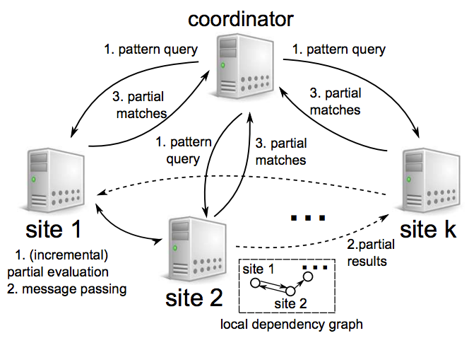
Distributed pattern matching: framework
A mixed strategy: partial evaluation + message passing
local evaluation to generate partial results
asynchronous message passing to direct partial results among fragments

Slide 9
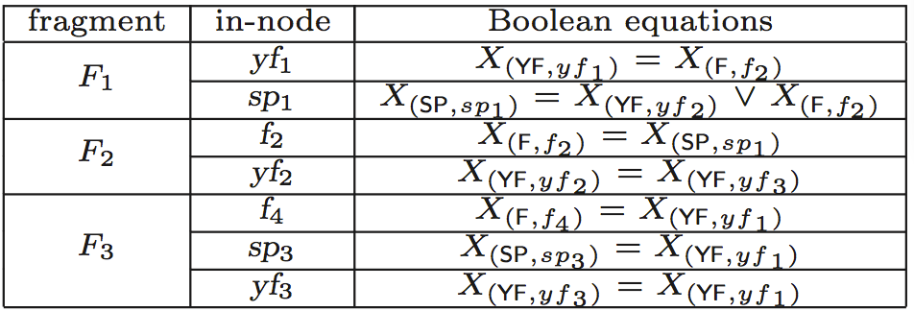
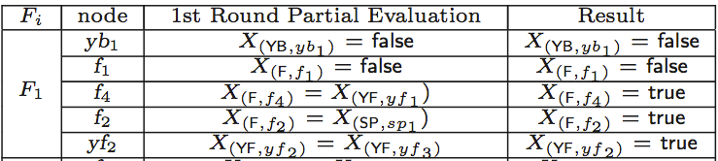
Partition bounded algorithm
Step 1: partial evaluation at each fragment
introduce Boolean variables to indicate if match or not
keeps track of unevaluated
in-nodes and virtual nodes
Step 2: each site refines partial answers upon receiving new msgs (in parallel and asynchronously)
ships partial answers to other sites
incremental update optimization
Step 3: coordinator collects partial answers and returns their union as Q(G)
f₁
f₄
yf₁
sp₃
yb₁
sp₁
f₂
yf₂

Slide 10
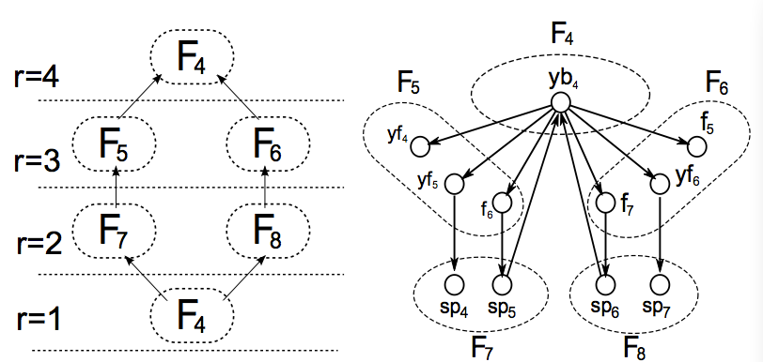
Parallel scalable algorithms: DAG patterns
Step 1: partial evaluation at each fragment
Step 2: each site sends msgs following the topological ranks of query nodes
waits until all Boolean variables for the nodes at same rank to be collected
send msgs in a single batch to reduce # of msgs
Step 3: coordinator collects partial answers and returns their union as Q(G)
YB1
YF
F
SP
YB3
YB2

Slide 11
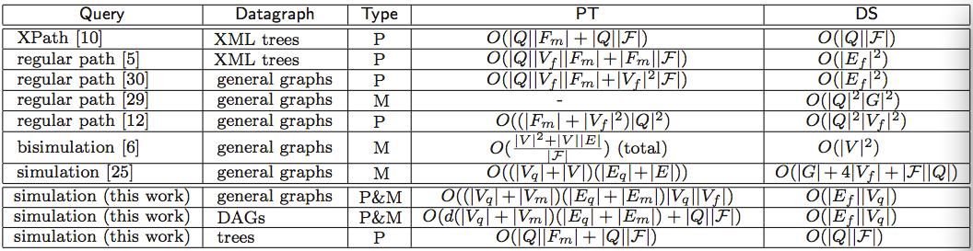
A big picture
Partial evaluation
bounds on response time and network traffic
redundant local computation
Message passing
unbounded data shipment and is hard to have provable bounds on response time
Local evaluation can be optimized with carefully designed routing/scheduling

Slide 12
Experimental evaluation
Dataset
Real-life graphs: Yahoo (18 million nodes and edges), Citation (4.4 million nodes and edges)
Synthetic graphs
Algorithms
Partition bounded algorithm dGPM
Scalable parallel algorithm dGPMd for DAG patterns
Above algorithms without optimizations (incremental update)
Centralized graph simulation
Baseline: disHHK [S.Ma, WWW ’12]
Notes:
The “wh” nodes in knowledge querying for knowledge graphs

Slide 13
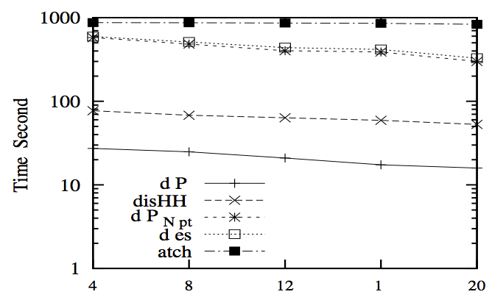
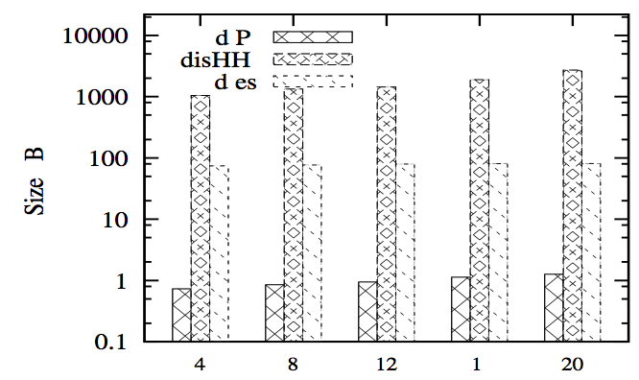
Efficiency of distributed graph simulation
response time
data shipment

Slide 14
Conclusion
Take away
Impossible to find distributed simulation algorithms that are parallel scalable in response time or data shipment
Provide algorithms that are partition bounded: time and data shipment are not a function in the size of data graph
These algorithm scale well with big graphs
Future work
Parallel scalability for other queries, e.g., subgraph isomorphism
Combining partial evaluation and message passing and compare with MapReduce and GraphLab
Combining distributed processing with optimizations: compression, view-based evaluation and top-k query evaluation
Notes:
The “wh” nodes in knowledge querying for knowledge graphs

